Slide 1

LSH Competition 2015: LSH Applications
LSH AVENGERS TEAM
Taehwan Park
Hwajeong Seo
Jongseok Choi
Ha Van Nguyen
Kyunghoon Kim
Sunhee Seok
13 / 8 / 2015

Slide 2
Internet of Things
Big Data
FinTech
File System
Compression
Disk Encryption

Slide 3

Iron Park: I found that NSR developed the new hash function namely LSH. What is LSH?
JARVIS: LSH is abbreviation of (Lightweight Secure Hash).
Iron Park: Is there any unique features in it?
JARVIS: Absolutely yes. This has software and hardware friendly architecture. Furthermore, it is secure against all critical hash function attacks.
Iron Park: What an incredible results! I want to apply LSH into our avengers secure infrastructures.
JARVIS: I got your order.

Slide 4
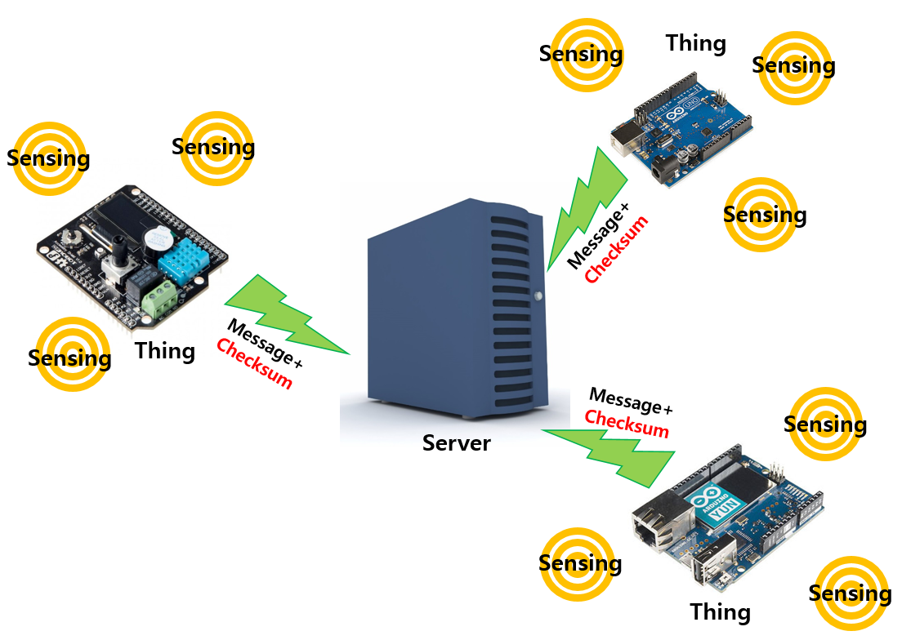
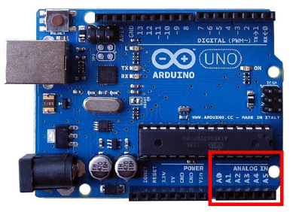
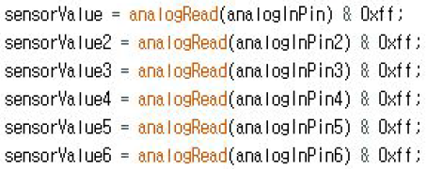
Internet of Things
:: Things sense the environment data and send to central server (checksum on message)

Slide 5
Internet of Things (results)
CPU: Atmega328@20MHz, Bluno v1.8
LSH₂₅₆
OS: N/A
Language/Complier: C(avr asm), Arduino 1.6.5
SHA₂₅₆
LSH-256
SHA-256
our code
Tzikis Lib
Algorithm
145.2 Kbps
14.8 Kbps
S/W
13.7 Kbps
8.17 Kbps
X1.67

Slide 6
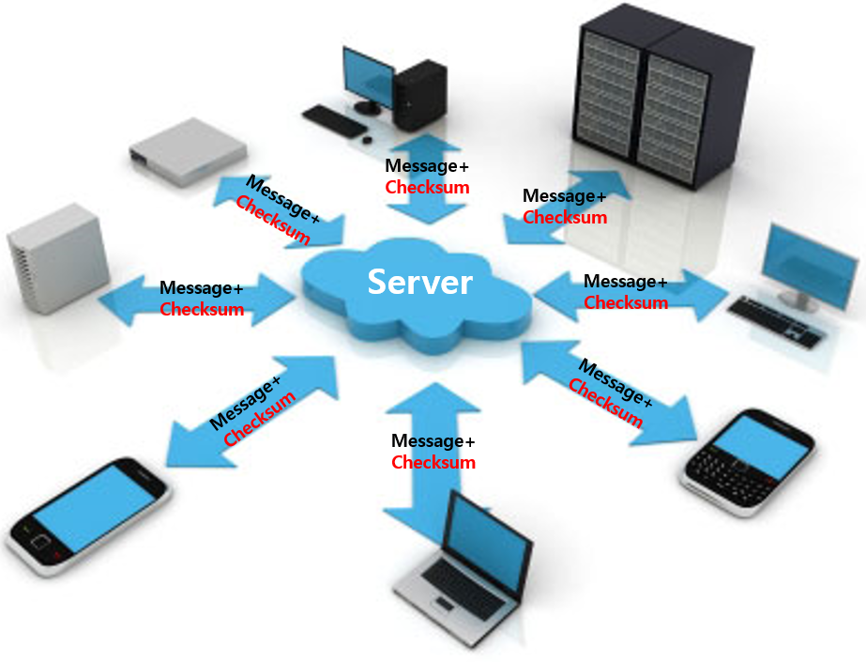
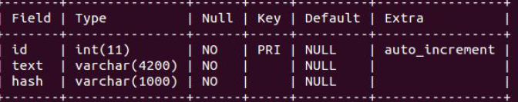


Big Data
:: Large collections of data is continuously produced and stored into database (checksum on message)

Slide 7
Big Data (results)
CPU: Intel Core i5-4200U@1.60GHz 64-bit
LSH₂₅₆
LSH₅₁₂
SHA₅₁₂
SHA₂₅₆
OS: ubuntu 14.04 LTS 64-bit
Language/Complier: C(avx2 intrinsic) / gcc 4.8.2
Database: MySQL 14.14
LSH-256
SHA-256
LSH-512
SHA-512
NSR op.
mysql
Algorithm
355 Mbps
N/A
551 Mbps
N/A
S/W
26.3 Kbps
25.1 Kbps
26.1 Kbps
25.2 Kbps
X1.04
X1.04

Slide 8
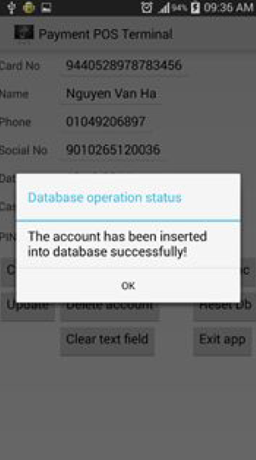
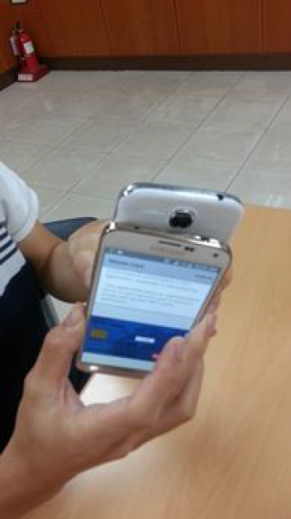
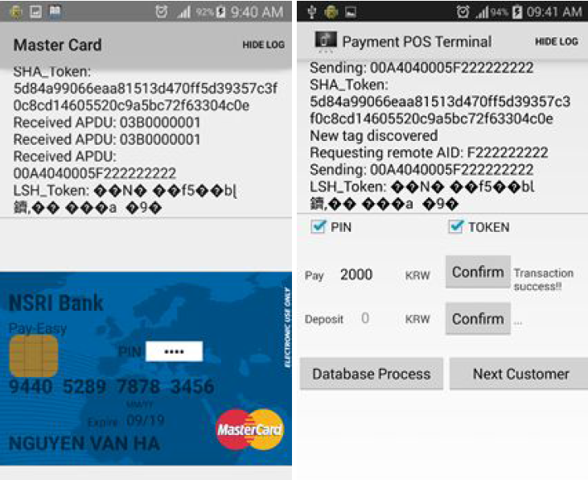
FinTech
:: Technology provides financial services using software (one-time token)

Slide 9
FinTech (results)
CPU: Qualcomm Snapdragon801@2.5GHz 32-bit
LSH₂₅₆
OS: android 4.4.4 32-bit
Language/Complier: C / gcc 4.9
LSH₅₁₂
LSH-256
SHA-256
LSH-512
SHA-512
NSR ref.
Java Lib
8B
4375 C/B
714 C/B
238 C/B
64375 C/B
13273 C/B
5019 C/B
10312 C/B
2023 C/B
674 C/B
86562 C/B
17023 C/B
5654 C/B
Algorithm
42B
SHA₂₅₆
126B
SHA₅₁₂
S/W
N/A
N/A
N/A
N/A

Slide 10
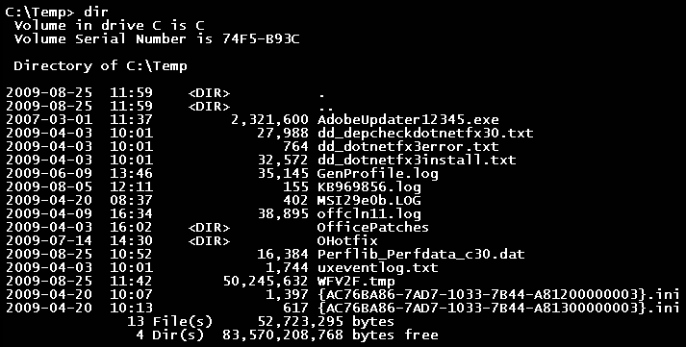
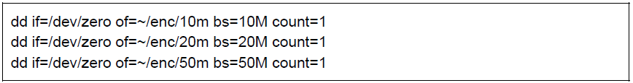
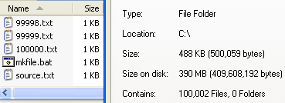
File System
:: System is used to control how data is stored and retrieved (checksum on Inode)

Slide 11
File System (results)
CPU: Intel Core i7-4790@3.6GHz 64-bit
LSH₂₅₆
SHA₁
OS: Mac OS X 10.10.4 64-bit
Language/Complier: C(avx2 intrinsic) / gcc 5.1.1
File system: EncFS
LSH-256
SHA-1
NSR op.
openssl
Algorithm
130.3 Mbps
96.9 Mbps
S/W
50 Mbps
50 Mbps

Slide 12
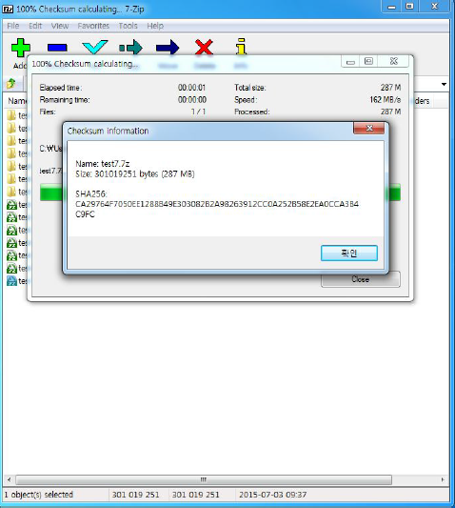
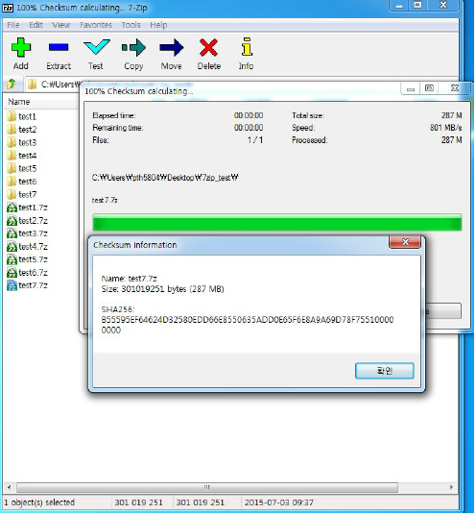
Compression
:: Data compression involves encoding information using fewer bits (checksum on message)

Slide 13
Compression (results)
CPU: Intel Core i7-3770@3.40GHz 64-bit
LSH₂₂₄
LSH₂₅₆
OS: Windows 7 32-bit
Language/Complier: C / gcc 4.9
Compression S/W: 7zip 15.05 beta
LSH-224
SHA-1
LSH-256
SHA-256
NSR op.
7zip
NSR op.
7zip
SHA₁
Algorithm
N/A
N/A
N/A
N/A
SHA₂₅₆
X4.85
X4.87
4.6MB
36.7MB
294MB
237Mbps
557Mbps
751Mbps
145Mbps
213Mbps
272Mbps
206Mbps
565Mbps
755Mbps
94Mbps
140Mbps
155Mbps
S/W

Slide 14
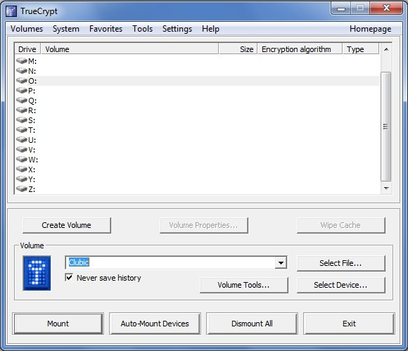
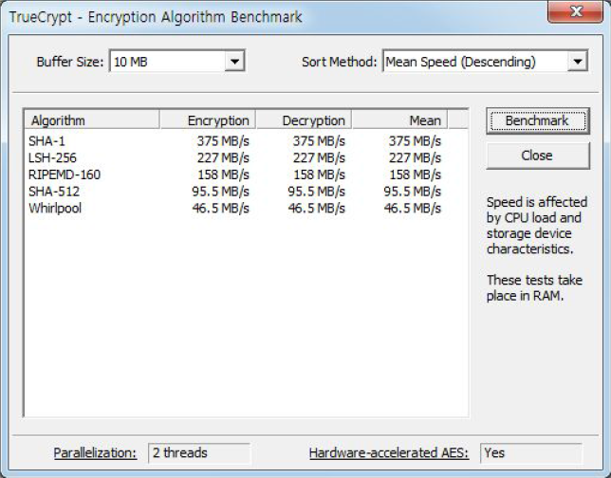
Disk Encryption
:: This creates a virtual encrypted disk within a file or encrypt a partition (checksum on message)

Slide 15
Disk Encryption (results)
SHA₁
CPU: Intel Core i5-4670@3.40GHz 64-bit
OS: Windows 7 64-bit
Language/Complier: C / Visual Studio 2008 SP1
LSH₂₅₆
Disk Encryption S/W: TrueCrypt 7.1a
LSH-256
SHA-1
SHA-512
NSR ref.
TrueCrypt
SHA₅₁₂
Algorithm
N/A
N/A
N/A
X2.8
100KB
10MB
100MB
210Mbps
230Mbps
226Mbps
350Mbps
379Mbps
371Mbps
75Mbps
110Mbps
96Mbps
S/W

Slide 16

Mission Completed

